Slide 1
FAIR INCOME PREDICTION: Addressing Gender Bias in Automated Decision-making
Notes:
University of Helsinki researchers:
Mirkka Sarparanta, Academy Research Fellow, Department of Chemistry Subunit
Tracers in Molecular Imaging (TRIM)
Jose Filipe Silva, Associate professor, Department of Philosophy, History and Art Studies

Slide 2
Story: Salary recommendation SYStem
A recruiting platform uses ML to predict whether job candidates are likely to earn >$50K annually. This prediction influences:
Initial salary offers
Job level recommendations
Benefits eligibility
We have been tasked to create a model to predict high-income earners based on demographic and employment-related features, helping the platform automate income classification and better understand candidate salary patterns.

Slide 3
Adult /census income dataset
Task: Predict whether an individual earns > $50K per year
Number of instances: 48,842 records
Number of features: 14 attributes (numerical and categorical)
Target variable: income (binary: ≤50K or >50K)
Sensitive attribute: Gender (Male / Female)
Key features:
- Age, Workclass, Education level,
- Marital status, Occupation, Relationship,
- Race, Hours per week, Native country
Mostly clean data but contains some missing values (represented as ?)

Slide 4
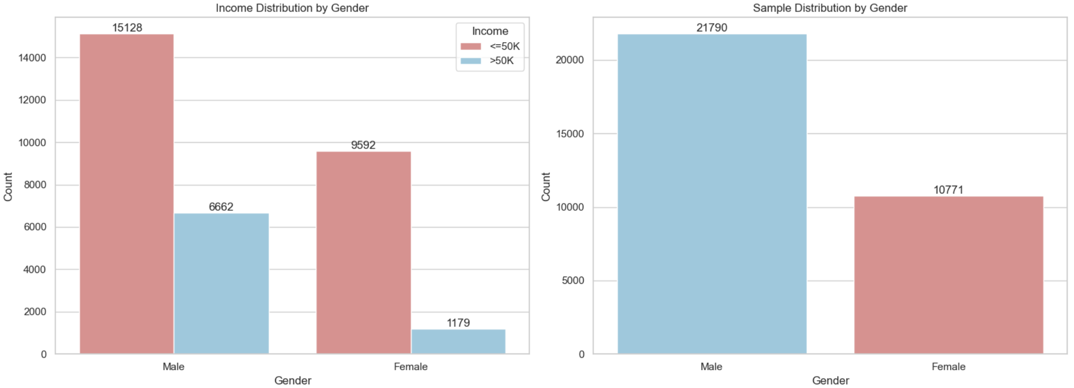
Distribution of Income and Gender in the Dataset

Slide 5
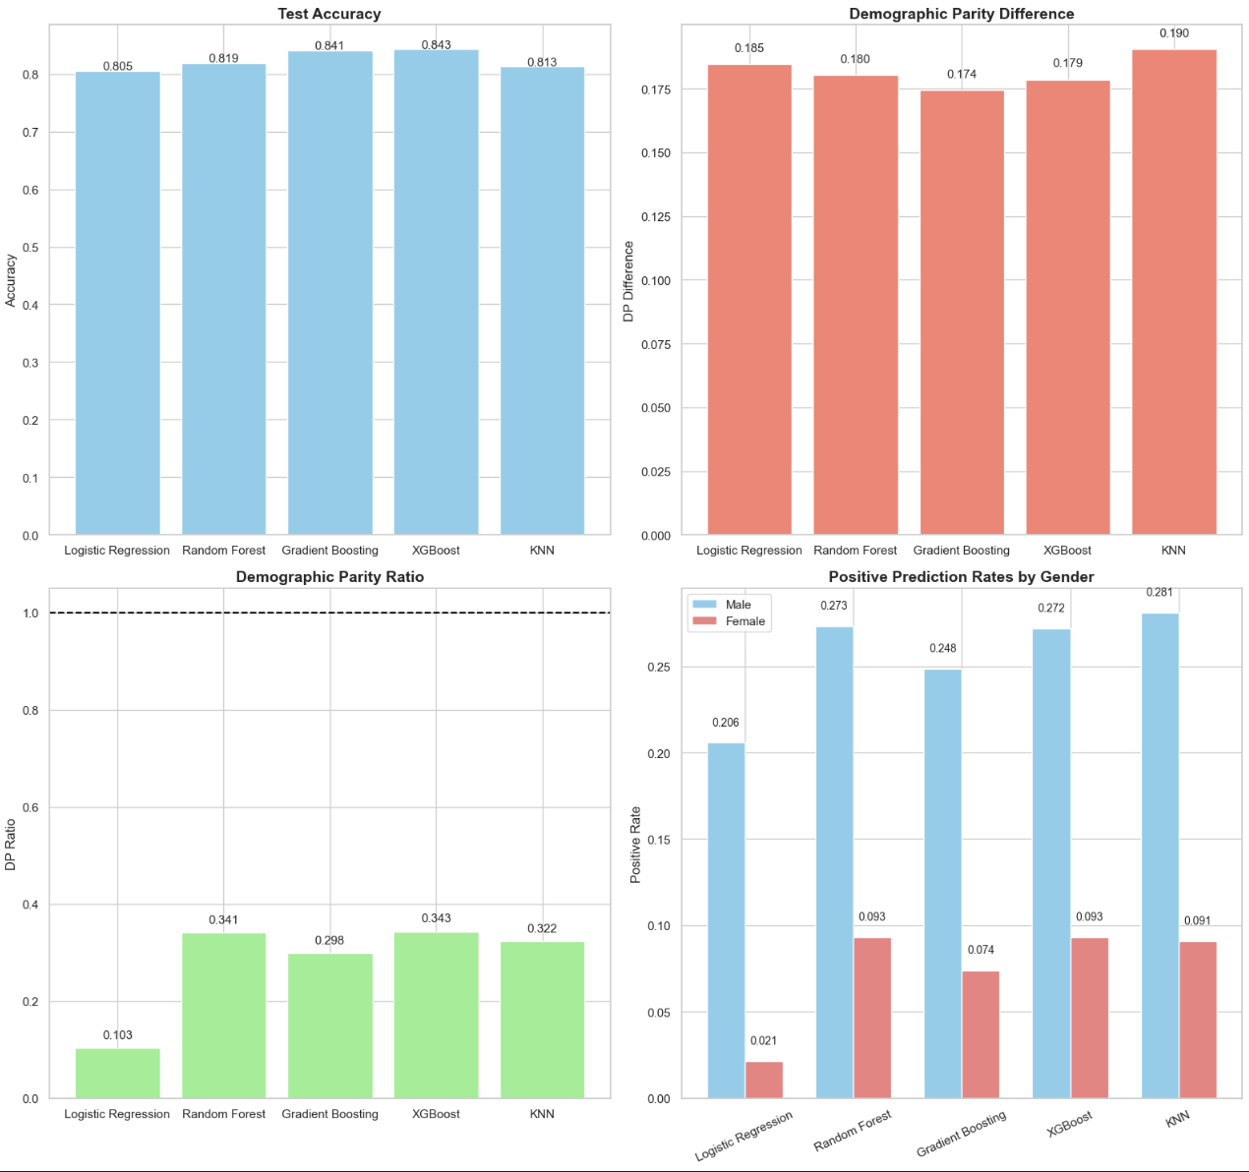
Comparison of Model Accuracy and Fairness Metrics

Slide 6
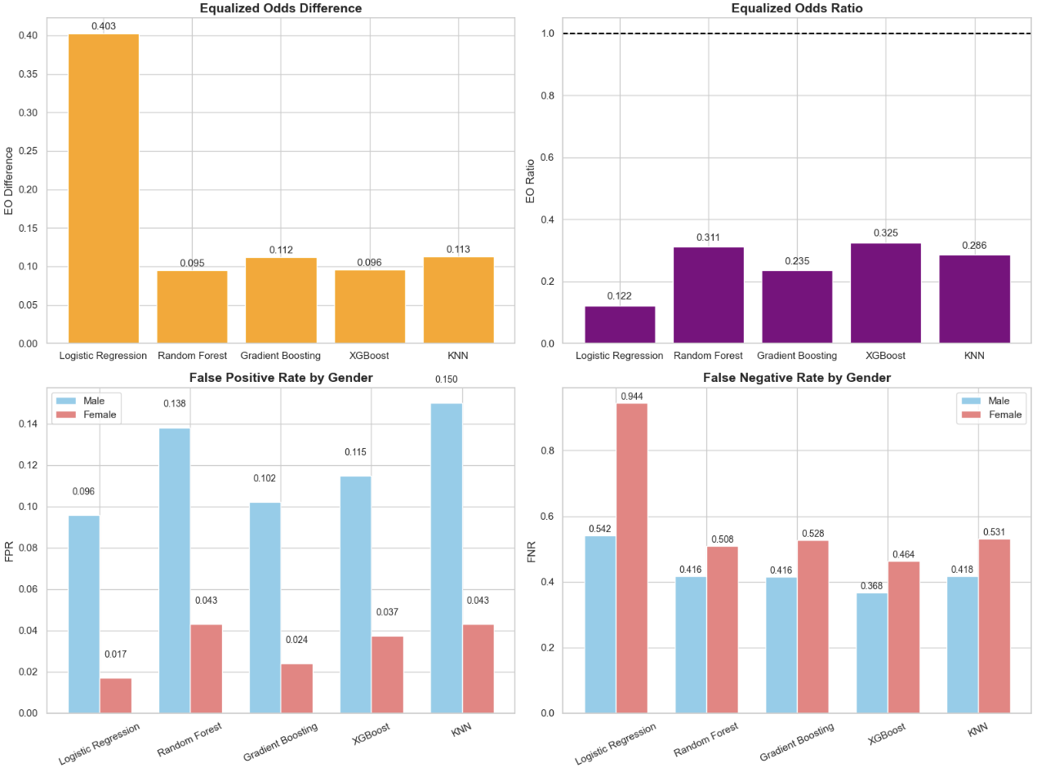
Fairness Metrics – Equalized Odds & Error Rates

Slide 7
Key findings
High Accuracy != Fairness
There is a gender gap in income, with males more likely to earn >$50K.
Models inherit biases from the dataset, reflecting existing disparities.
Positive prediction rates and error patterns differ by gender, highlighting systemic inequalities.
Even accurate models can produce unfair outcomes if sensitive attributes are ignored.
Understanding data distributions and disparities is critical before deploying ML systems.

Slide 8
Thank You
Any Questions?

